Slide 1
CT3112: Professional Skills Topic 3: Health & Safety Risk Assessment – Control the Risk
Martina Kelly
Mechanical Engineering

Slide 2
Control the Risks
Section 8 of the 2005 Act requires that every employer ensures, "so far as is reasonably practicable, the safety, health and welfare at work of his or her employees"
This duty requires that an employer “has exercised all due care by putting in place the necessary protective and preventive measures, having identified the hazards and assessed the risks to safety and health likely to result in accidents or injury to health at the place of work concerned and where the putting in place of any further measures is grossly disproportionate having regard to the unusual, unforeseeable and exceptional nature of any circumstance or occurrence that may result in an accident at work or injury to health at that place of work.”

Slide 3
Control the Risks
A control measure is simply what steps you are going to take to remove a hazard (eliminate) or at least reduce it to a low level (minimise).
Your control measures are the most significant part of the risk assessment, as they set out the steps that must be followed to protect people.
Some control measures may already be in place. You will need to decide if additional measures are needed. When deciding on the controls, you should consider the general principles of prevention. These are a hierarchy of controls that set out how to manage hazards. The focus should be to get rid of the hazard, so that people are protected. If this is not possible then you should work through the principles until you have made it as safe as reasonably practicable. Your reliance on personal protective equipment (PPE) should be one of the last steps in the process (not the first!).

Slide 4
Hierarchy of Controls Nine Principles of Prevention
Avoid the risk: -If you can get rid of the hazard then people are not exposed to the risks. You should apply this principle first
Evaluate unavoidable risks -: This requires you to undertake risk assessments. If you can’t get rid of a hazard, you must assess it
Combat the risks at source:- Here you are trying to deal with the hazard at its root. For example if you have a noisy machine in your workplace, giving employees hearing protection is not dealing with the root of the problem. If you enclose the machine so that it is not noisy or if you replace the machine with a quieter one, then you are combating the risk at source.

Slide 5
Hierarchy of Controls Nine Principles of Prevention
Adapt the work to the individual-: This is the principle of arranging the workplace and tasks to take into account your employees and to reduce the affect of work on health.
Adapt your work place in line with technical progress - Safer systems of work are always being developed. You should keep up to date with new systems, so that you can put them into use in your workplace. The HSA, trade associations, industrial bodies and trade unions will have information on safe systems of work that will help you

Slide 6
Hierarchy of Controls Nine Principles of Prevention
Replace dangerous systems with safer alternatives - This applies to dangerous articles, substances or systems of work. For example, if you are using a solvent that may be toxic, then you should consider if there is a non-solvent alternative that is safer. Basic approach - if you can take steps to make it safer, then do it.
Develop a prevention policy - This is where you would set out how you are going to protect your employees and other people from the hazards in your workplace. This forms part of your safety statement.
Give priority to collective protective measures - Here it is better to put controls in place that protect everyone, rather than for example just handing out PPE to employees.

Slide 7
Hierarchy of Controls Nine Principles of Prevention
Give training and instruction - Once you have assessed the risks and decided on your controls in line with the principles above, you will need to tell your employees about them and to make sure that they are competent to work safely.
Remember: Personal Protective Equipment is the last line of defence.

Slide 8
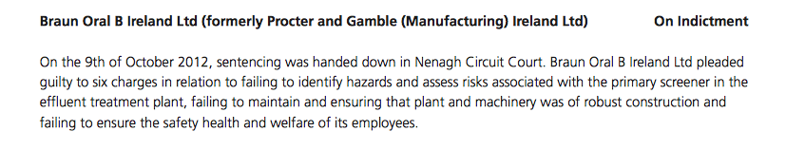

Slide 9
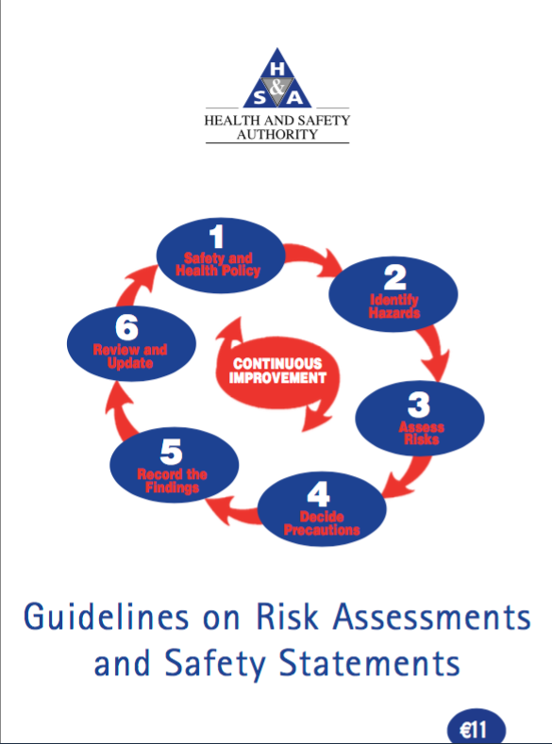
Record your Findings & Implement
Irish Legislation requires a ‘written risk assessment’.
This can be integrated in your Safety Statement
http://www.hsa.ie/eng/Publications_and_Forms/Publications/Safety_and_Health_Management/Guidelines_on_Risk_Assessments_and_Safety_Statements.pdf

Slide 10
Penalties
Whilst the penalties can vary, breach of an employer's duty is an offence, which may result in potential fines of up to €5,000 or imprisonment for a term of up to twelve months, or both, for each offence prosecuted in the District Court.
For more serious offences prosecuted on indictment in the Circuit Court, a fine of up to €3 million or imprisonment for a term of up to two years, or both, may be imposed, for each offence.

Slide 11
Penalties
In addition, under the 2005 Act, directors, managers and officers can be prosecuted individually. Where an offence has been committed by a company, and it can be demonstrated that the offence has been authorised or consented to by, or is attributable to connivance or neglect on the part of, a person being a director, manager or other similar officer of the undertaking, or a person who purports to act in any such capacity, that person can also be individually punished.

Slide 12
Review and Update as Necessary
Review annually and/or whenever there is a change in the workplace
Workplace reorganisation
New equipment
New staff etc..

